Slide 1

ELC Molecular Epi Training Nextstrain Practice on HPAI
Leke Lyu & Tanin Rajamand
20 June 2024

Slide 2
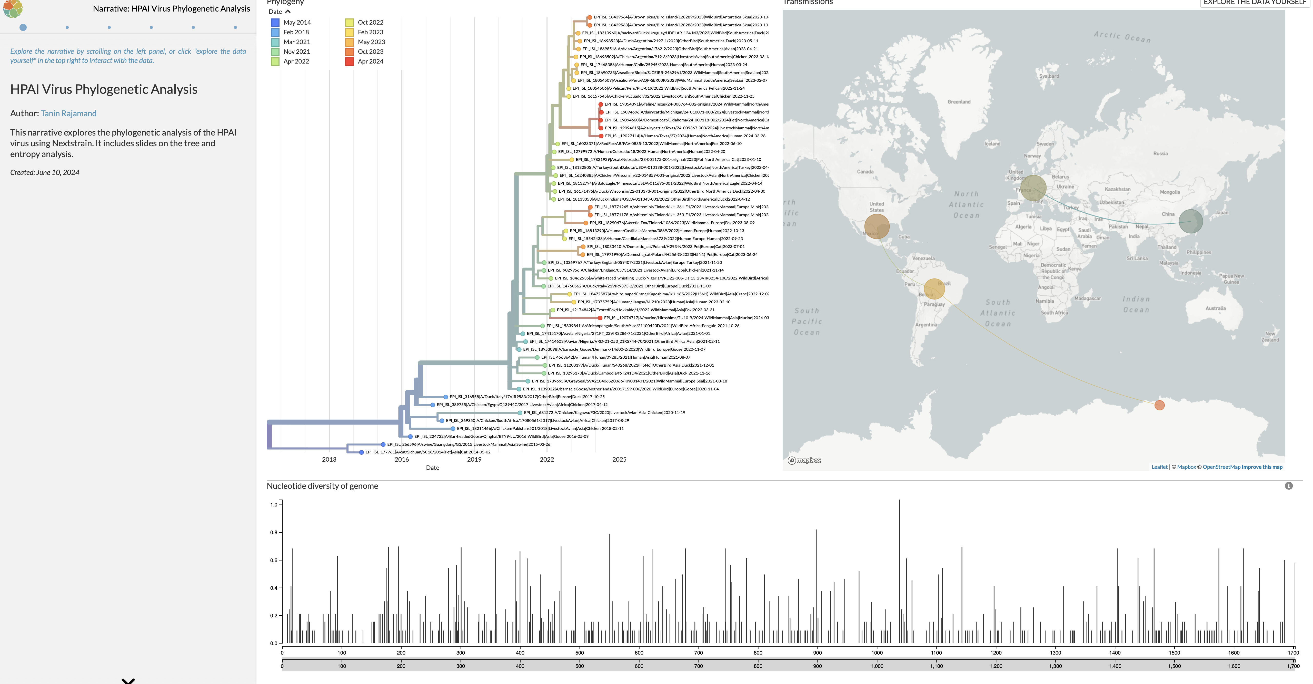
https://nextstrain.org/community/narratives/taneenak/HPAI/slides

Slide 3
Research Question:
Investigate Geographic Dispersal and Cross-spices Transmission Events of HPAI
Download data in: git clone https://github.com/leke-lyu/elcTraining

Slide 4
Files we need to check:
colors.tsv
lat_longs.tsv
auspice_config.json
HPAI_outgroup.gb
Snakefile
Cheat folder:
https://github.com/taneenak/HPAI-tutorial

Slide 5
Share your build and narrative!

